Slide 1
Apollo Tyres Global R&D IT Support for R&D

Slide 2
Agenda:
Introduction and status
Way Forward
Next steps

Slide 3
Agenda:
Introduction and status
IT Strategy
Global IT Organization
Complexity of IT systems
Resources from R&D working on IT
Way forward
Next steps

Slide 4
IT Strategy Introduction and status
There is no clear IT strategy:
From Apollo
From R&D
From IT
As a result:
No alignment of IT goals and priorities with R&D goals and priorities (who comes first will be served first)
IT process and performance are not visible to the R&D organization
Unclear if IT is supporting the right R&D priorities

Slide 5
Global IT Organization Introduction and status
On global level there is not enough steering on which and how processes should be supported by (global) IT systems.
As result systems supporting the same processes have no interface with each other.
One of the examples is the current Lims system in Hungary where there is an other version used which is not compatible with our Lims system and there is no decision made who is responsible to get these systems aligned and how to do this.
Notes:
Hungary is a perfect example …

Slide 6
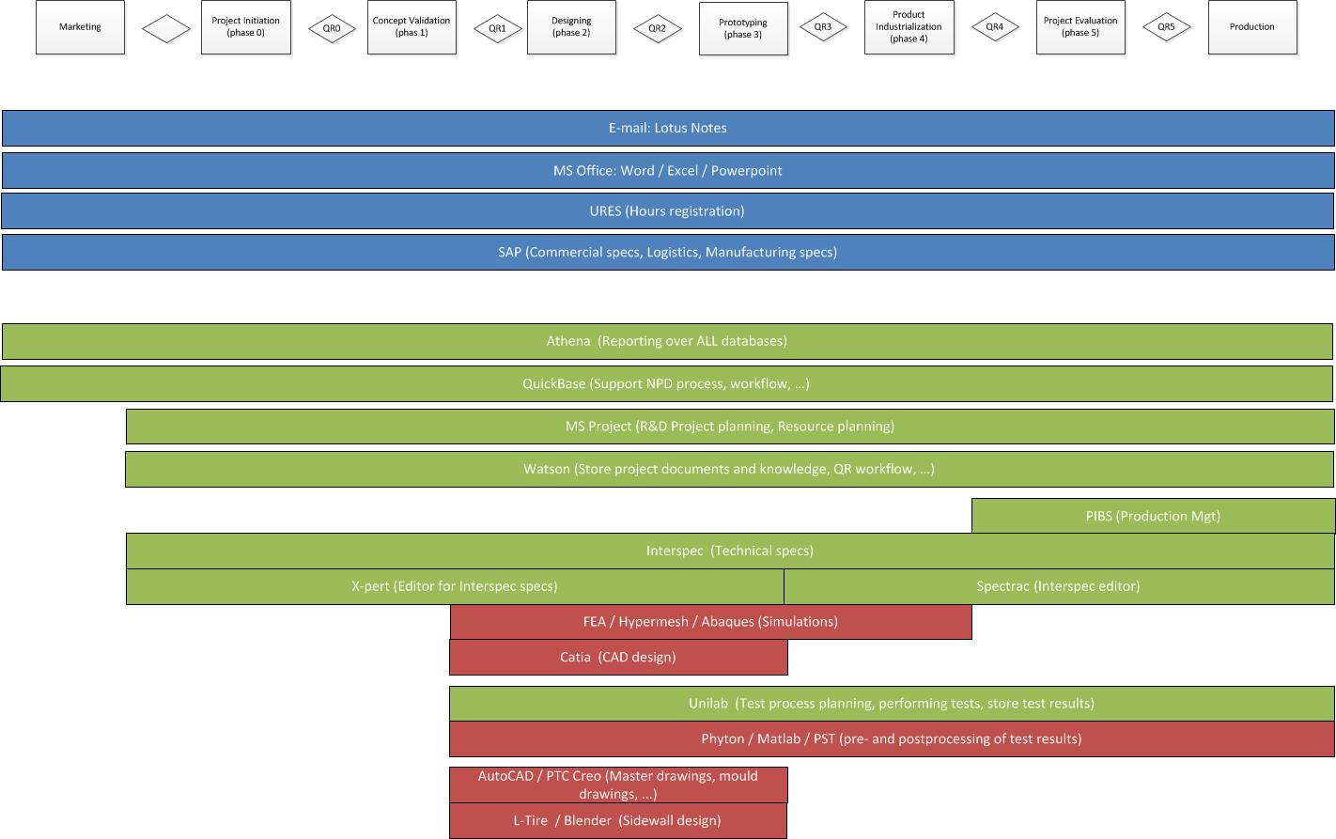
IT Systems & processes mapping (NPD) Introduction and status
Notes:
Two slides, to show current IT systems from different perpectives.
The first one (this slide) shows the major IT systems in respect to the NPD process. In which part of the NPD process are they bei ng used.
Different challenges are:
Who is the owner of an application? Technically and functionally.
Some of these applications are also used by other Apollo processes like: marketing and production.

Slide 7
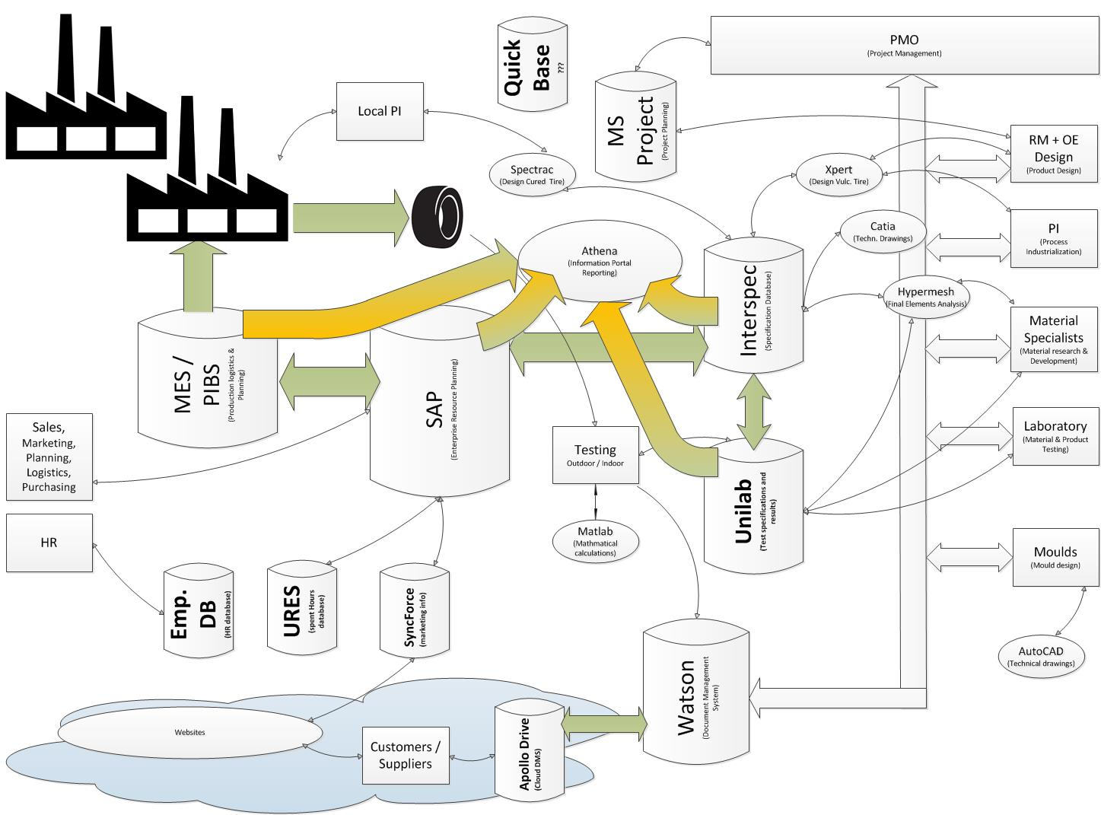
IT landscape Introduction and status
Notes:
This slide shows the same systems with another perspective. It shows the dependencies between the different systems. Some dependencies cross the interdepartmental borders.
Changes made in one system have impact on other systems and processes.

Slide 8
Results from enquiry Introduction and status
There is limited training available on IT systems
There are no or limited SOP’s or employees don’t know that they are there or where to find them
Employees are not trained or very limited trained on the job on IT systems
Employees don’t know where to find information and where knowledge is stored
No ownership on systems
It’s not clear who is responsible for the (cross functional) process
Dedicated excel sheets are being used during the development process. Because employees don’t –want to- use / know the possibilities of systems.

Slide 9
Process overlap with other disciplines Introduction and status
Marketing&
Sales
Knowledge
(Watson)
R&D
NPD Process
(Watson / QuickBase /
MS Project)
Trial programs
(Unilab & Intersoec)
Product Specifications
(Interspoec)
Product Quality
(Unilab)
Manufacturing
Business intelligence: Reporting (Athena)

Slide 10
IT Systems / R&D resources Introduction and status
Admin & Business support:
Watson | Mobility
Time Registration | Pace or Tasper
MS Office + mail | Project planning
SAP | Infrastructure
}IT
Admin & Business Support
}IT+R&D
R&D Proces Support
Primary R&D process support:
Watson | Lims
Xpert | PLM
Development
Dedicated
applications
Development:
Abaques | Catia
Hypermesh | AutoCAD
Matlab, m-files | Xpert
Adams | Phyton
Analytical relation tools
Test result processing tools | FEA post processing tools
}R&D/Supplier
Partly global appl.
General global applications
Notes:
About ownership. Both functional and technical.
Ownership / responsibility is not that black and white as one might expect.
Some applications are 100% IT responsibility (Admin & Business support) others have a shared responsibility (primary R&D process support) while there is even a group of applications that is completely R&D responsibility (Development)
The ones with a shared responsibility, there is a need for R&D process expertise to specify how these systems should work.

Slide 11
Responsibility matrix IT – R&D Introduction and status
 | Functional ownership | Technical ownership | Software licences& access | Hardware & Network | 1st line application support | 2nd line application support | 3rd line application support
Admin & business support | IT | IT | IT | IT | IT | Supplier
Primary R&D process support | R&D | IT * | IT* | IT | R&D | IT* | Supplier
Development | R&D | R&D | IT | IT | R&D | Supplier
Functional ownership:
Access definition
Configuration and report definition
Technical ownership:
User management & access
Implementation and maintenance of custom code and reports
Notes:
This slide highlights the different responsibilities per application group.

Slide 12
Agenda:
Introduction and status
Way forward
R&D, IT Strategy
Organization
Global IT Organization
Next steps

Slide 13
Way forward
R&D
Create a clear strategy for R&D how to improve / become more efficient
Derive from that strategy an IT roadmap with clear priorities
Establish an ownership / responsibility matrix per IT system
Establish a “steering committee” to control the IT systems change process. As an example the current NPD process could be used.
Have IT report on a regular basis to this steering committee
Define key users per IT system to support steering committee on functional level
Globaly:
Establish a global steering committee for interdepartmental systems like: SAP, Lims and others
Global IT should be more involved in major business decisions

Slide 14
R&D Strategy Way forward
What does R&D need to become even more efficient?
What are the current weaknesses?
How can IT support the improvement projects?
Do we continue our current focus on:
Lims
Simulations
Xpert
Planning
Or do we need to change focus?

Slide 15
Organization Way forward
Steering committee for IT systems:
To decide which new projects to start
To decide on project priorities and resources
To decide on major system changes
Have a regular progress review (on IT systems)
Use a project approach like NPD
Start with feasibility study – Project proposal
Be aware of interfaces / interaction with other systems
Have QR gates to control progress

Slide 16
Agenda:
Introduction and status
Way Forward
Next steps

Slide 17
Next steps

Slide 18
Slides below are just for reference purposes.
Not to be shown unless needed.

Slide 19
Business needs
R&D Goals (2017/18) | R&D Process | IT process / People Involved
Support Ramp-up Hungary | Global/Local PI | Interspec: Patrick, Nico Interspec/Unilab interface: Patrick Unilab configurution/setup: Hans
PI Plan | Global PI Moulds Moulds PMO | Project & Resource planning: Patrick Business team template: Patrick COP: Mathias / Patrick / Jos de Gier Xpert 2.0: Mathias / Patrick / Waldemar / Bertus Spectrac: Mathias / Bertus Automate sidewall engraving: Patrick/Alban Watson for moulds: Jacco Watson (improve QR): Jacco Watson (update): Jacco / Silverside
Notes:
These are just some examples This is a result of my talks with all the R&D heads about their Horizon departmental goals. It shows what is required and who can work on it.

Slide 20
Business needs
R&D Goals (2017/18) | R&D Process | IT process / People Involved
Adherence to budget | All Airmaster OE Finance PMO | Athena reports: Alban Unilab (optimise test requests): Patrick
First time right | Materials Testing RM / AE | Athena reports: Alban Statistica Unilab (distributed FEA automation): Patrick/Atos Unilab (tests in time): Patrick / Izaak Unilab (Unilab in Chennai): Patrick/Nico/Hans New warehouse management system: Patrick/ICT Spirit
Selectively strengthen R&D | Testing RM / AE | Data communication (improve data-connectivity with test tracks): Helpdesk R&D Watson (share information globally): Patrick / Jacco
Notes:
These are just some examples

Slide 21
Current IT Organization
Notes:
On paper, this is our global IT organization

Slide 22
IT department at R&D
Name | Function
Patrick | Projects (see list on next sheet) SW development & Support All SW and infrastructure
Alban | Reporting (Athena)
Mathias | Software development: Interspec, X-pert, Spectrac
Jacco | Software development & DB administration: Oracle (Interspec & Unilab) Lotus Domino (Watson)
Tobias | User support

Slide 23
IT Projects overview Running projects
System | Company | Department | Project owner | Main topic | Description
Interspec | Apollo PV R&D / Hungary | Global Quality | Pedro de Matos | Global Lims | Global Interspec Interface Interspec - SAP Interface Intersoec - Unilab
Unilab | Global QA | Global Quality | Pedro de Matos | Unilab 7 | Specify / Configure / Test / Give consultancy on Unilab implementation
Lims | Apollo PV R&D | Testing | Peter Roest | Global Lims | Lims in Chennai
Xpert | Apollo PV R&D | Global PI | Hitesh | Spectrac / Xpert | Xpert 2 Spectrac 3 Enhance Spectra / catia
Watson | Apollo PV R&D | Moulds | Gerlof | Watson | Mould drawings in Watson
? | Apollo PV R&D | Global PI | Hitesh | Global PI planning | Global PI planning
Athena | Apollo PV R&D | PMO | Marc vd Broeke | Hours & Costs reporting per project | Athena report to show hours booked (URES) and money spent (SAP) per project
Watson | Apollo PV R&D | PMO | Barbara Jansink | Watson | Project management in Watson
Lims | Apollo PV R&D | IT | Patrick | Lims | Replace old Lims test server
Watson | Apollo Vredestein | QA | Mauricio Sampaio | QMS in Watson | Controlled QMS documents in Watson and on Intranet
Watson | Apollo Vredestein | SHE | Daan Feijer / Manfred Rudolf | SHE in Watson | Controlled SHE documents in Watson and on Intranet
Watson | Apollo Global QA | Global QA | Pedro de Matos | Quality documents in Watson | Controlled global quality documents in Watson
Interspec | Apollo Vredestein | Manufacturing | Tobias Ekkels | Replace AS400 by Interspec | Spacemaster in Interspec
Interspec | Apollo PV R&D | OEM | Jos de Gier | Lims | COP in Lims

Slide 24
IT Projects overview Closed projects
Presentation rooms | Apollo PV R&D | R&D | Peter Snel | R&D activities | More user friendly CR7
Watson | Apollo PV R&D | PMO | Thomas | PMO | New QR workflow
Infrastructure | Apollo PV R&D | R&D | Thomas | Frankfurt Office | Frankfurt Office
MS Project | Apollo PV R&D | PMO | Thomas | PMO | MS Project project planning
Xpert | Apollo PV R&D | Global PI | Hitesh | Xpert | Xpert
Lims | Apollo PV R&D | Advanced Engineering | SKP | FEA | FEA
Watson | Hungary | Global PI | C. Krishnakumar | Watson | Install Watson on Hungary server
Presentation rooms | Apollo PV R&D | R&D | Peter Snel | Raunheim | Extra VC facility for large room
LIMS | Apollo PV R&D / QA | R&D | Hans van Benthem | Global LIMS | Improve interface between Interspec and Unilab

Slide 25
Costs overview (1/2)
COST ITEM | AMOUNT | TOTAL AMOUNT PER DEP. | CHARGE GLOBAL R&D | CHARGE GLOBAL MAN. | CHARGE GLOBAL QUAL.
Patrick + Alban |  |  | 200
Temporary labour/outsourced work | 819 |  | 291
R&D (charge to global R&D) |  | 151 | 151
Maintenance TCE software (Daisy) | 7
Maintenance MATLAB (The Mathworks) | 17
Maintenance LIMS (Atos/Siemens) | 35
Abaqus (4Realsim) | 92
GENERAL (ca 100 Euro per IT-user) |  | 195 | 14 | 2
Maintenance virus scanners | 16
Maintenance Spoolmail | 1
Maintenance Webfocus | 36
Maintenance Hyperstage BI + adapt | 50
Maintenance Misc. | 4
Consumables (paper etc.) | 2
Misc. Materals and repair | 26
Contribution BTG & NEN | 2
KPN Aspace fax services | 7
VM-ware Maintenance SAN | 4
Maintenance Watson document system | 10
Maintenance Lotus Notes | 10
Support Silverside | 12
Annual licenses terminal server | 15
Rent for copiers and printers incl. Basic Qty prints | 85 | 92 | 6 | 1
Additional prints black/white | 4
Additional prints colour | 3
Lease PC-systems + servers 3 year |  | 265 | 26 | 4
Sub-Total |  |  | 688 | 7

Slide 26
Costs overview (2/2)
Sub-Total from previous page |  |  | 688 | 7
COST ITEM | AMOUNT | TOTAL AMOUNT PER DEP. | CHARGE GLOBAL R&D | CHARGE GLOBAL MAN. | CHARGE GLOBAL QUAL.
Data Communication
Hire glass fibre ring AVBV – R&D – Apollo Distri. (Trent) | 25 |  | 20
Echelon maintenance glass fibre ring (Echelon) | 8 |  | 5
Internet access (Echelon) | 3 |  | 0.5 | 0.5 | 0.5
Connection Enschede 10 MB on KPN-network | 14
Connection Enschede – Gurgaon India 12 MB | 53 |  | 3.5 | 3.5 | 3.5
Connection NDIX – Enschede (1 Gb) | 6 |  | 1.5 | 1.5 | 1.5
Connection NDIX – Amsterdam (100 Mb) | 7 |  | 1.5 | 1.5 | 1.5
Connection NDIX – Frankfurt (1 Gb) | 20 |  | 20
Lease PABX | 45 |  | 5 | 1
Total |  |  | 745 | 15 | 7 | 767

Slide 27
Costs breakdown

Slide 28
IT Architecture (example)
ERP (SAP)
PLM
Reporting
Ideas
Requirements
Portfolio
Feasibility
Planning
Purchasing
Scorecards
Team
Collaboration
Specification
Management
Recipe
Management
Planning
Dashboards
Document
Management
Trial Testing
Recipe
Transformation
Accounting
Benchmarking
Finance
Quality
Management
Site Recipe
Management
Analytics
Logistics
Reports
Primary Process
Production
Logistics
Filling & Packaging
Storage &
Transfers

